Slide 1


Educational Gamification Platform
https://github.com/Meshva-p/SOEN_6841_Project
Transforming Learning Through Gamified Education
Group 1:
Jasmanpreet Kaur Bedi 40231120
Anirudh Boddu 40225271
Meshva Patel 40255073
Aswiin Ravi Prakash 40278497

Slide 2
Introduction: Revolutionizing Learning for the Digital Age
Today's classrooms face a common challenge: how to engage students in an increasingly digital world where attention spans are fleeting and traditional teaching methods often fall short.
Traditional education lacks the engagement and interactivity needed to captivate the minds of modern learners, leading to disinterest and disengagement.
Enter the solution: Educational Gamification. By integrating game mechanics and principles into the learning process, we have the power to revolutionize education and transform passive learners into active participants.
Join us on a journey to explore how our Educational Gamification Platform is reshaping the landscape of learning, making education more engaging, effective, and enjoyable for students and educators alike.

Slide 3

Market Justification: Tapping into Educational Technology Trends
Market Analysis Findings:
Rapid Growth in EdTech: The global education technology market is experiencing exponential growth, with a projected market size of $404 billion by 2025, driven by the increasing adoption of digital learning solutions and the shift towards online education (Source: Research and Markets).
Rising Demand for Gamified Learning: The gamification market in education is expected to grow at a CAGR of 32% between 2021 and 2026, reaching a value of $7.8 billion, indicating a significant demand for gamified learning platforms (Source: Mordor Intelligence).
Emphasis on Personalized Learning: Personalized learning platforms are gaining traction, with 88% of teachers expressing interest in using adaptive learning technologies to meet individual student needs (Source: EdSurge).
Addressing Accessibility Needs: The global e-learning market, driven by the need for accessible and flexible learning solutions, is projected to reach $374.3 billion by 2026, reflecting the growing emphasis on accessibility and inclusivity in education (Source: Globe Newswire).

Slide 4

Project Relevance and Potential Success: Harnessing Market Trends for Success
Aligning with Market Trends:
Our project capitalizes on these key trends, offering a gamified learning platform that provides personalized, engaging, and accessible learning experiences.
Meeting Evolving Needs:
By addressing the demand for interactive and adaptive learning solutions, our project meets the evolving needs of educators, students, and educational institutions in the digital age.
Competitive Advantage:
With a focus on innovation, usability, and content relevance, our project aims to differentiate itself in the market and establish a competitive edge.
Market Growth Opportunities:
The projected growth of the education technology market presents significant opportunities for our project to gain traction, expand its user base, and achieve long-term success.

Slide 5
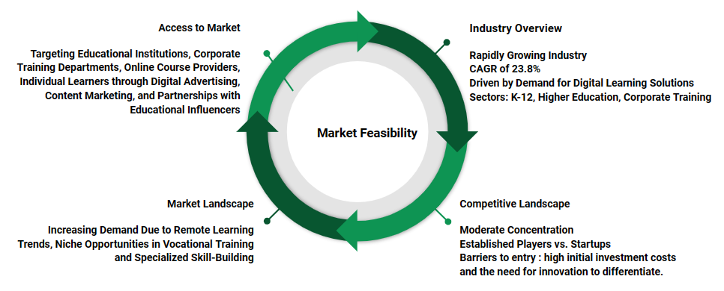
Feasibility Study
Economic Feasibility
Expense Category | Estimated Cost ($)/yearly | Expense Category | Estimated Cost ($)/yearly
Development Costs | $100,000 - $600,000+ | Initial Product Rollout | $30,000
Testing Costs | $150,000 | AWS Costs | $20,000
Tech infrastructure | $50,000 | Storage Costs | $10,000
Office Space | $100,000 | 3rd Party Integration Costs | $15,000
Tech Equipment | $75,000 | Licensing and Legal Fees | $25,000
Training | $20,000 | Deposits | $15,000
Research and Development | $50,000 | Travel | $10,000
Marketing | $200,000 | Buffer Allowance | $50,000
Maintenance and Support | 20% - 30% of development cost | Employee Payroll | $80,000
In terms of Technical Operations Impact Analysis, the Potential Challenges that could arise:
Integration Complexity: Careful planning and collaboration are required for integrating the new software into existing educational workflows.
User Adoption: Educators and students may require training and support for effective use, necessitating investment in comprehensive training programs and user-friendly interfaces.
Technical Dependencies: Reliance on cloud infrastructure and third-party services introduces risks to system availability and performance, mitigated by implementing contingency plans and SLAs.
Compliance and Regulation: Ensuring compliance with data protection laws and standards involves establishing robust data governance practices and conducting regular compliance audits.

Slide 6
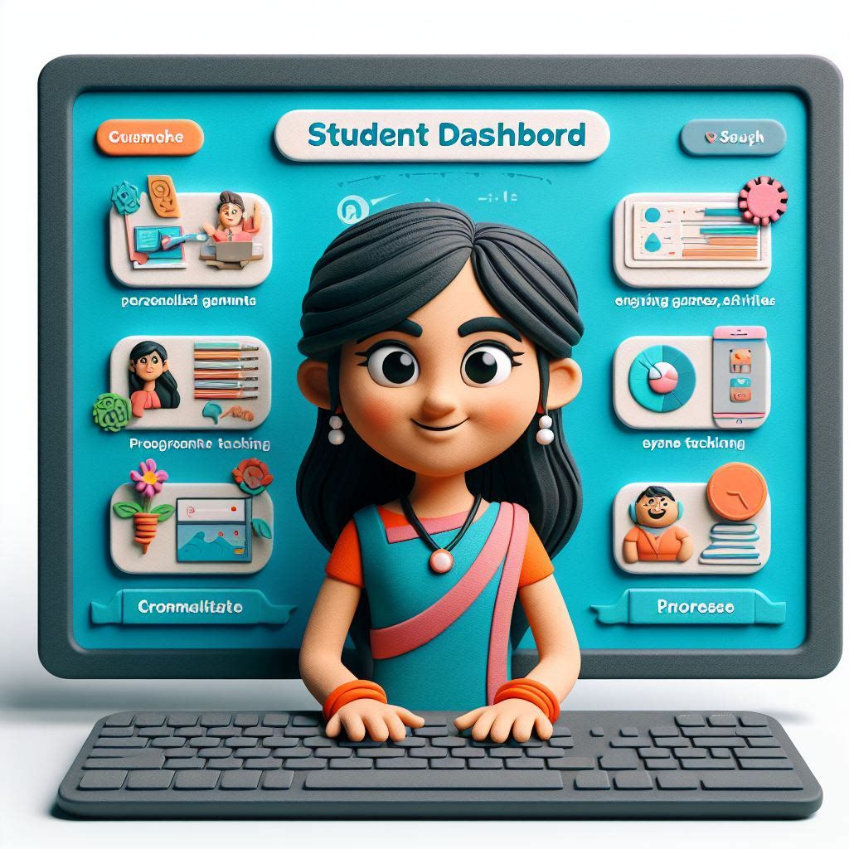



Solution Highlights: Unlocking the Power of Educational Gamification
Virtual Classroom: Experience dynamic online learning environments where educators engage students through interactive lessons, simulations, and collaborative activities.
Game Library Canvas: Empower educators with tools for streamlined lesson planning, data-driven instruction, and personalized feedback to enhance teaching effectiveness.
Student Dashboard: Elevate students' learning experiences with personalized learning paths, engaging games and activities, and comprehensive progress tracking.
Educator Dashboard: Dive into a world of educational games and puzzles designed to reinforce key concepts and make learning enjoyable.

Slide 7
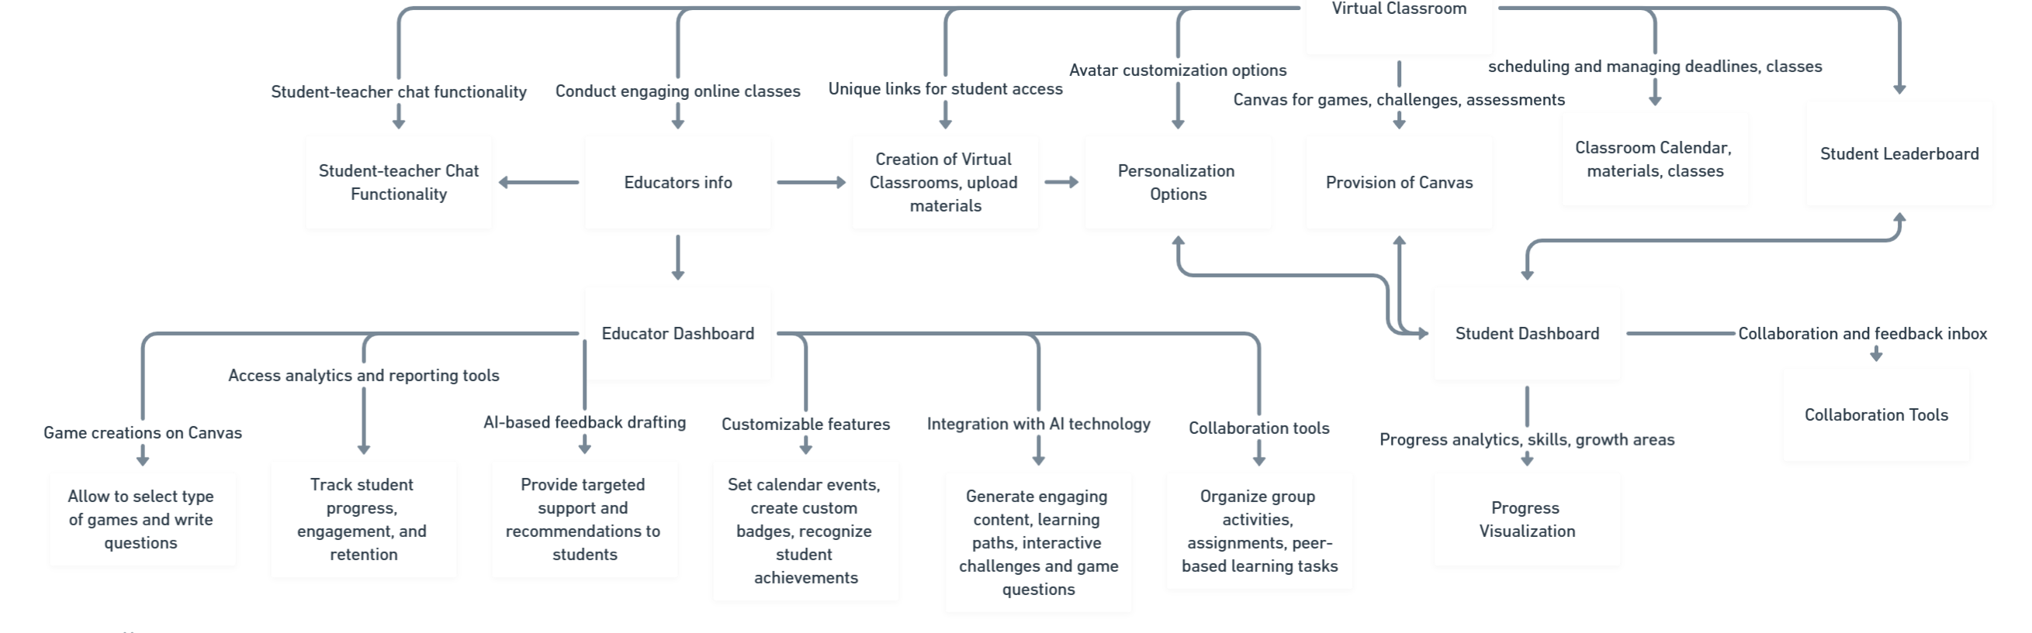
Personalized lesson plans and interactive activities enhance comprehension and engagement, leading to better learning outcomes.
Increased Student Engagement: Gamification elements such as badges and rewards motivate students, resulting in higher participation and retention rates.
Enhanced Teaching Practices: Data-driven insights enable educators to tailor instruction, address individual needs, and refine teaching methods, fostering continuous improvement.
Our solution

Slide 8
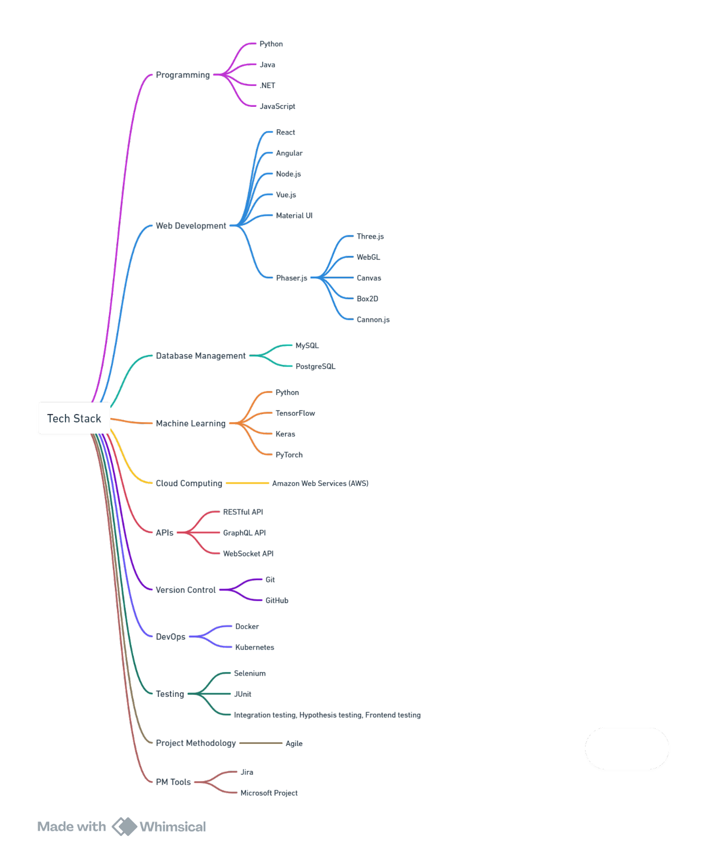
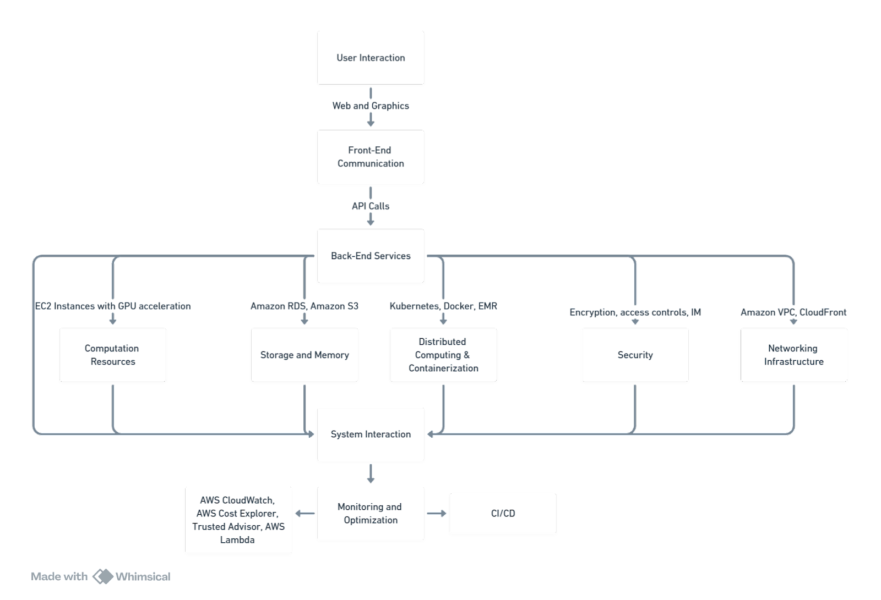
Tech Stack and System Interaction
This also highlights the technical feasibility of our system. The technical requirements for our software can be met by utilizing AWS cloud services and modern development frameworks with integration of AI/ML, gaming libraries providing a contemporary and scalable educational platform.

Slide 9
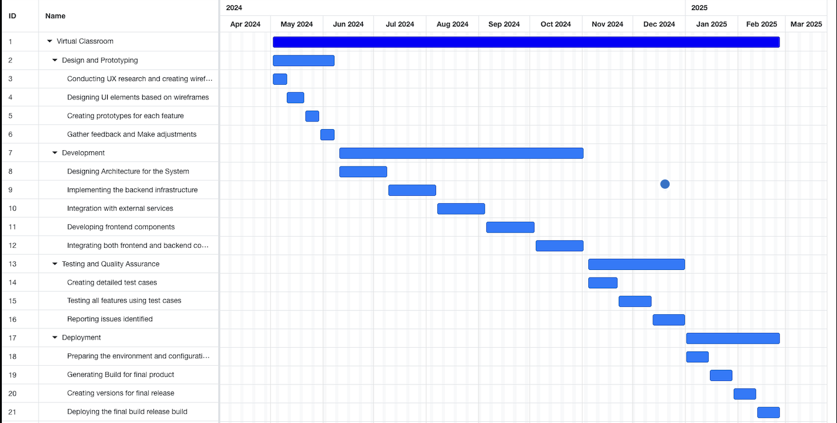


Project Plan Overview
Detailed Plan - Plan Details

Slide 10
Risk Management Overview
Technical Risks:
Gamification Implementation Challenges
Scalability Concerns
Data Security
Content Development Challenges
Operational Risks:
User Engagement
Content Management
Technical Support
Community Building
Economic Risks:
Budget Constraints
Monetization Strategy
Market Competition
Legal and Compliance Risks:
Data Privacy Regulations
Intellectual Property Rights
Accessibility Compliance
User Experience Risks:
Usability Issues
Feedback Mechanisms
Content Relevance

Slide 11
Budget Overview
Budgeting for the project is divided into key categories to ensure thorough planning and efficient resource allocation. Development costs cover frontend and backend development, AI integration, and analytics modules, totaling $450,000. Testing costs, crucial for software reliability, amount to $150,000, while deployment costs, including beta release and optimization, reach $100,000. Marketing expenses for launch and maintenance costs for ongoing improvements sum up to $875,000. This detailed breakdown ensures effective management and execution of the project within budget constraints.

Slide 12
Resource Costing and Contingency Budget
Market Response
Risk Management
External Dependency Failures
Scope Changes
Human Resources
Contingency Budget
Resource Costs
Lead Developer
Software Engineers
AI Specialist
Testing Team -2
Gamified Analytics Developers
Backend -4
Frontend -2
UI/UX -2
Deployment and Optimization -2
Marketing and Support
Manager
Team Member
System Administrator
Customer Support Representatives - 2
The project's resource costing encompasses a diverse team of skilled professionals crucial for translating vision into a cutting-edge educational gamification solution. From lead developers to AI specialists and marketing teams, each member plays a vital role in ensuring the platform's success. With a total resource cost of $1,980,000, our project budget is set at $2,855,000, encompassing both resource and other essential expenses
A contingency budget is vital for handling unexpected costs during the project. We've set aside 10% of the total budget for this purpose, covering risks like technology glitches, scope changes, and human resource needs. With this adjustment, our total project budget becomes $3,140,500, ensuring we're prepared for any surprises while keeping the project on track.

Slide 13
Transforming Learning Experiences with EduQuest- Conclusion and Call to Action…
Market Feasibility: Growing demand for digital learning solutions
ROI: Demonstrated financial viability and sustainability
Risk Mitigation: Prepared to navigate challenges with resilience
Vision: Shaping the future of education together
Provide Feedback: Your insights are crucial in refining EduQuest for success.
Commit to Collaboration: Let's forge strong partnerships to drive innovation.
Engage with Us: Schedule follow-up meetings to become part of Legacy
Join the Pilot Program: Become early adopters and experience EduQuest firsthand
Take the Next Step: Sign on as a partner, invest, or express your commitment to support EduQuest
Take Action with EduQuest
Let's Shape the Future of Education Together!

